Slide 1
Lecture 7
System Modeling
Mobeen Nazar
Senior Lecturer
Software Engineering Department

Slide 2
Objective
  System Perspective
  UML Diagram types
  Use of Graphical Model
  Use case Modeling
  Scrum

Slide 3
System modeling
System modeling is the process of developing abstract models of a system, with each model presenting a different view or perspective of that system.
System modeling has now come to mean representing a system using some kind of graphical notation, which is now almost always based on notations in the Unified Modeling Language (UML).
System modelling helps the analyst to understand the functionality of the system and models are used to communicate with customers.
Chapter 5 System Modeling

Slide 4
Existing and planned system models
Models of the existing system are used during requirements engineering. They help clarify what the existing system does and can be used as a basis for discussing its strengths and weaknesses. These then lead to requirements for the new system.
Models of the new system are used during requirements engineering to help explain the proposed requirements to other system stakeholders. Engineers use these models to discuss design proposals and to document the system for implementation.
In a model-driven engineering process, it is possible to generate a complete or partial system implementation from the system model.
Chapter 5 System Modeling

Slide 5
System perspectives
An external perspective, where you model the context or environment of the system.
An interaction perspective, where you model the interactions between a system and its environment, or between the components of a system.
A structural perspective, where you model the organization of a system or the structure of the data that is processed by the system.
A behavioral perspective, where you model the dynamic behavior of the system and how it responds to events.
Chapter 5 System Modeling

Slide 6
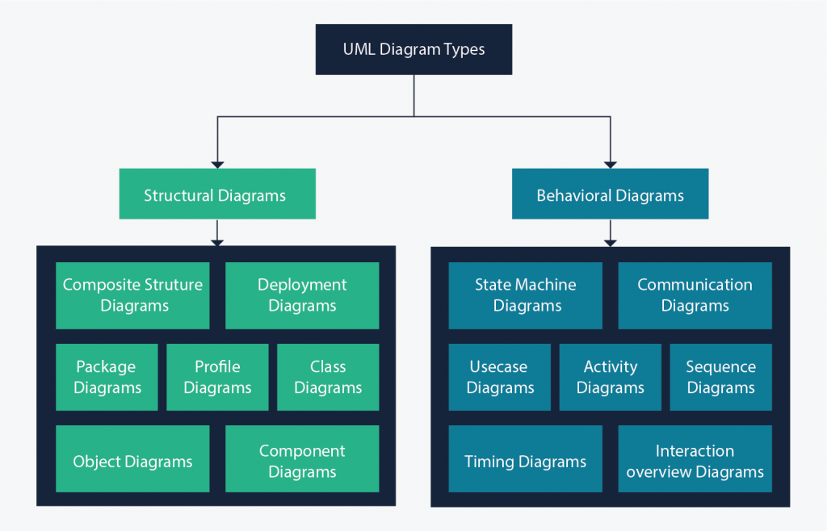
UML diagram types
Chapter 5 System Modeling

Slide 7
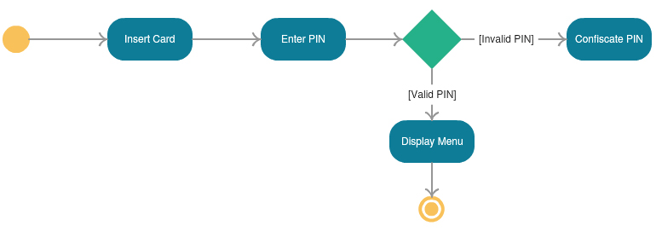
Activity Diagram
show the activities involved in a process or in data processing. They can be used to describe the business workflow or the operational workflow of any component in a system.
Chapter 5 System Modeling

Slide 8
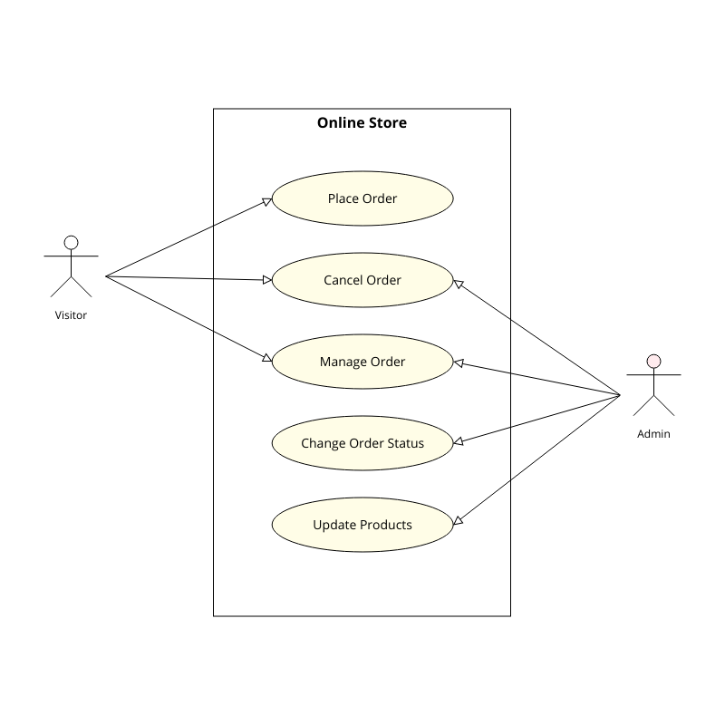
Use Case Diagram
Use case diagrams give a graphic overview of the actors involved in a system, different functions needed by those actors and how these different functions interact.

Slide 9
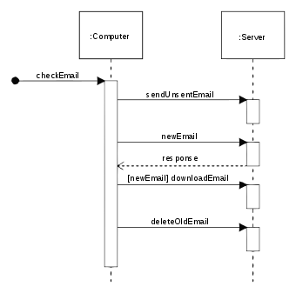
Sequence Diagram
show how objects interact with each other and the order those interactions occur
Chapter 5 System Modeling

Slide 10
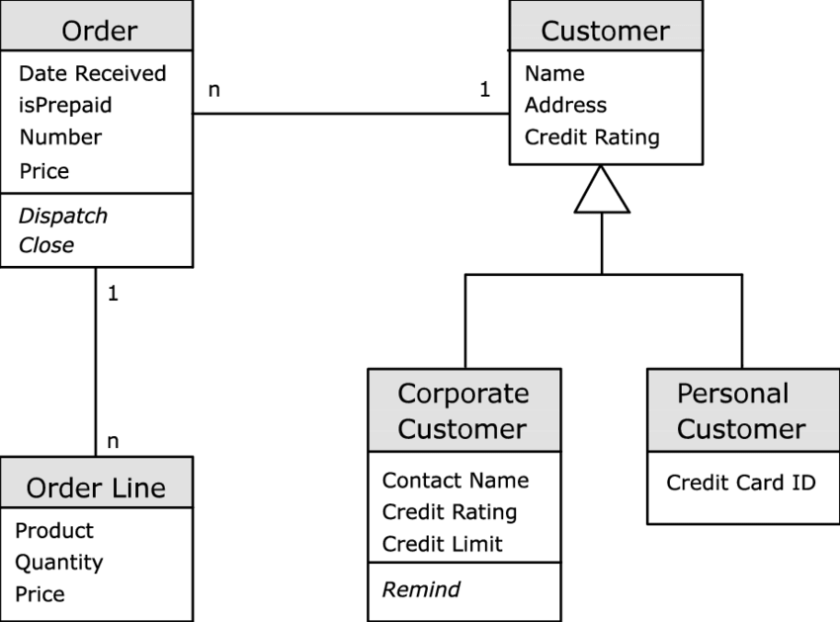
Class Diagram
Show the object classes in the system and the associations between these classes.
Chapter 5 System Modeling

Slide 11
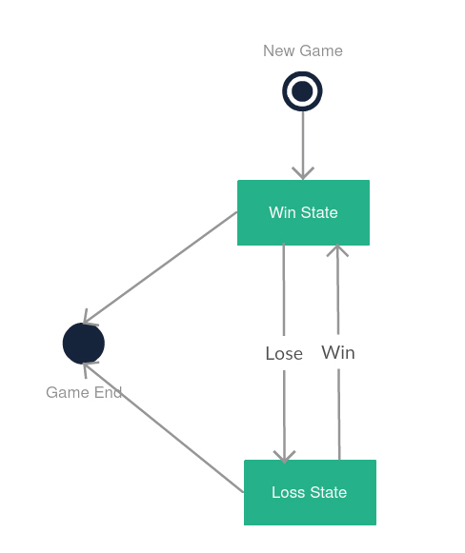
State Diagram
These are very useful to describe the behavior of objects that act differently according to the state they are in at the moment.
Chapter 5 System Modeling
Notes:
https://creately.com/blog/diagrams/uml-diagram-types-examples/
These are very useful to describe the behavior of objects that act differently according to the state they are in at the moment.

Slide 12
Context Diagram
A system context diagram represents all external entities that may interact with a system.
The entire software system is shown as a single process.
Such a diagram pictures the system at the center, with no details of its interior structure, surrounded by all its External entities, interacting systems, and environments.
It is also known as DFD (Data Flow Diagram)
Chapter 5 System Modeling

Slide 13
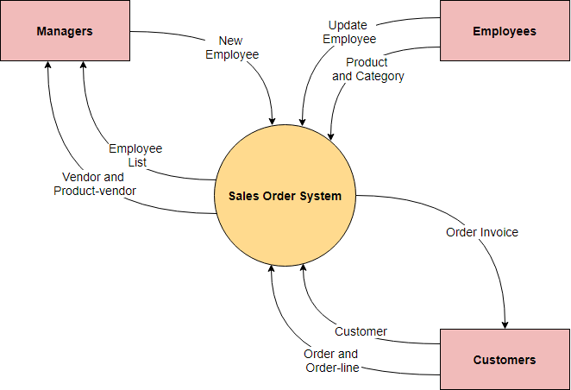
Context Diagram (Sale Order System)
Chapter 5 System Modeling

Slide 14
Process perspective
Context models simply show the other systems in the environment, not how the system being developed is used in that environment.
Process models reveal how the system being developed is used in broader business processes.
UML activity diagrams may be used to define business process models.
interaction model diagrams modeling system to system interaction.
Chapter 5 System Modeling

Slide 15
Context models
Context models are used to illustrate the operational context of a system - they show what lies outside the system boundaries.
Social and organisational concerns may affect the decision on where to position system boundaries.
Architectural models show the system and its relationship with other systems.
Chapter 5 System Modeling

Slide 16
Interaction models
Modeling user interaction is important as it helps to identify user requirements.
Modeling system-to-system interaction highlights the communication problems that may arise.
Modeling component interaction helps us understand if a proposed system structure is likely to deliver the required system performance and dependability.
Use case diagrams and sequence diagrams may be used for interaction modelling.
Chapter 5 System Modeling

Slide 17
Structural models
Structural models of software display the organization of a system in terms of the components that make up that system and their relationships.
Structural models may be static models, which show the structure of the system design, or dynamic models, which show the organization of the system when it is executing.
You create structural models of a system when you are discussing and designing the system architecture.
Chapter 5 System Modeling

Slide 18
Behavioral models
Behavioral models are models of the dynamic behavior of a system as it is executing. They show what happens or what is supposed to happen when a system responds to a stimulus from its environment.
You can think of these stimuli as being of two types:
  Data Some data arrives that has to be processed by the system.
  Events Some event happens that triggers system processing. Events may have associated data, although this is not always the case.
Chapter 5 System Modeling

Slide 19
Data-driven modeling
Many business systems are data-processing systems that are primarily driven by data. They are controlled by the data input to the system, with relatively little external event processing.
Data-driven models show the sequence of actions involved in processing input data and generating an associated output.
They are particularly useful during the analysis of requirements as they can be used to show end-to-end processing in a system.
Chapter 5 System Modeling

